Slide 1
Introduction and Overview
NE 763: Advanced Reactor Materials and Materials Performance
Fall 2026
Dr. Benjamin Beeler

Slide 2
Housekeeping
Course will be administered on Moodle
If you haven’t already checked Moodle, do so. If you are unsure how to access, then ask me
Lectures will be posted after the class
Have also made a class slack channel for quick communication
everyone should have either received an invite, or already has access

Slide 3
In Person/Hybrid
Lectures will be recorded and available on Panopto
All slides will be available on Moodle
I have a Zoom classroom set up to do simulcasting
Can attend in-person or remotely, but in-person is preferred

Slide 4
Exams, Projects, Grading
Using the standard NCSU +/- grading system, as broken down in the syllabus (which is on the moodle)
Four exams will be conducted during normal class hours – 20% each
Will set up an exam period via zoom for distance students
One project presentation will be via PPT and conducted during normal class hours – 20%
Distance will upload recorded presentation
No final exam
If this changes, sufficient advance notice will be given

Slide 5
Office Hours
Set for Wednesdays 9:00-10:00 am, my office is BU 1110c
Additional meetings can be set up on request
Don’t hesitate to schedule these
If I don’t know you need help, then I can’t help

Slide 6
Feedback
I will be reaching out for feedback periodically throughout the semester (probably once in the middle, once in the end)
I want this course to provide information that is currently not included in other courses, or to further expand upon materials issues that are briefly touched upon elsewhere
I want to make sure that this class is able to meet the needs of the students, provides relevant information, and is taught at a level commensurate with the abilities of the students, and I need your feedback to do that

Slide 7
Syllabus
Course Overview
This course discusses materials evolution and performance in advanced reactor systems, addressing the current state of knowledge for advanced fuels, cladding, and coolants. Students will gain relevant knowledge to address advanced materials questions in the next generation of nuclear reactors. Systems of interest include high-temperature gas reactors, sodium-cooled fast reactors, molten salt reactors, small modular reactors, research reactors, and more.
Topical Outline
Introduction
TRISO/HTGRs
SFRs
Molten salts and Ceramics
Research reactors
Advanced reactor cladding
Potentially other stuff, if we have time (probably wont…)

Slide 8
Resources
No official textbook
I pull a lot of material from “Comprehensive Nuclear Materials”
two versions, info pulled from both
Can consult this online textbook for further references and potentially clarification
Other information pulled from review articles or my own knowledge/experience

Slide 9
This Class is Conceptual
There are not going to be ‘work-through’ problems
I am going to talk through concepts, systems, phenomena, etc.
Thus, you should be asking a lot of questions as we go through
The class is improved by questions, and everyone’s understanding is improved if we talk, back-and-forth, through topics

Slide 10
Advanced reactor systems

Slide 11
What do I mean by advanced reactors?
Several generations of reactors can be distinguished
Generation I reactors were developed in 1950-60s, and are no longer operational
Generation II reactors are the present US and French fleets and most in operation elsewhere

Slide 12
What do I mean by advanced reactors?
Generation III or III+ have been constructed and typically have:
A more standardized design for each type to expedite licensing, reduce capital cost and reduce construction time
A simpler and more rugged design, making them easier to operate and less vulnerable to operational upsets
Higher availability and longer operating life – typically 60 years
Further reduced possibility of core melt accidents
Stronger reinforcement against aircraft impact than earlier designs, to resist radiological release
Higher burn-up to use fuel more fully and efficiently and reduce the amount of waste
Greater use of burnable absorbers ('poisons') to extend fuel life

Slide 13
Generation III Reactors
The greatest departure from Gen II reactors is the incorporation passive of safety features
Construction is often modular, allowing for offsite manufacturing and onsite assembly
Examples include AP1000 (maybe III+), EPR, ABWR

Slide 14
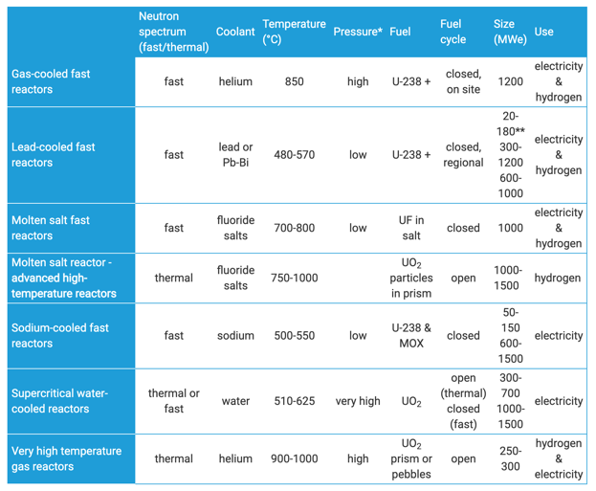
What do I mean by advanced reactors?
Generation IV
designs are largely still conceptual
typically incorporates five-seven reactor designs
four of these types are fast reactors
all operate at higher temperatures
all systems represent advances in sustainability, economics, safety, reliability, and proliferation-resistance

Slide 15
Selected Advanced Reactor Designs
GEN III+ PWRs: Westinghouse: AP-1000, AP-600; Framatome: EPR; KHNP: APR+; Gidropress: VVER-1200
GCR: Framatome: SC-HTGR; GA: Prismatic HTR
SFR: CEA: ASTRID; JAEA: JSFR; GE-Hitachi: PRISM
MSR: Terrestrial: IMSR-400; Flibe Energy: LFTR; Seaborg: MSTW
Can consult the Advanced Reactors Information System (ARIS) from the IAEA for more information: https://aris.iaea.org/

Slide 16
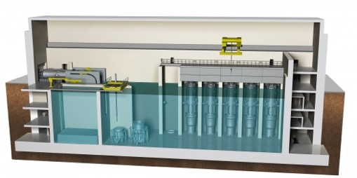
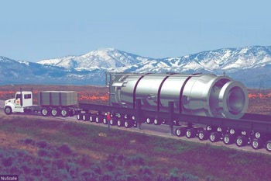
What do I mean by advanced reactors?
Small Nuclear Reactors
Small Modular Reactors (SMRs)
Micro-Reactors
Reduces the cost associated with building 1000 MW scale reactors, and can provide power away from large grid system
SMRs are 300 MWe or less, designed with modular technology using module factory fabrication, pursuing economies of series production and short construction times
Microreactors (or very small modular reactors vSMRs) are up to 25 MWe

Slide 17
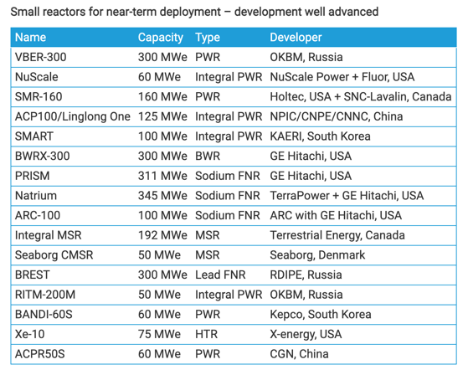
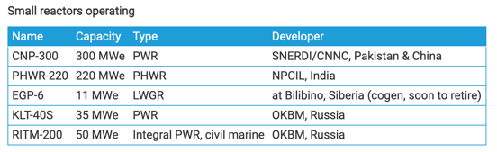
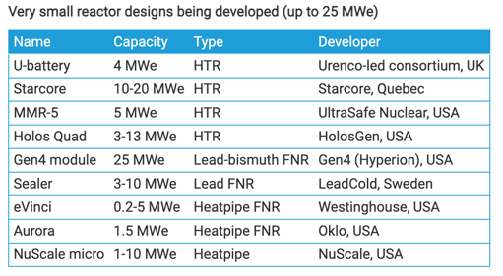
Small Nuclear Reactors

Slide 18
DOE Push for Advanced Reactors
DOE is funding a lot of research into advanced reactor systems
The Advanced Reactor Demonstration Program (ARDP) seeks to rapidly develop advanced reactor concepts
The National Reactor Innovation Center (NRIC) supports the construction and demonstration of advanced reactor systems committed to demonstrating advanced reactors by the end of 2025
The Office of Advanced Reactor Technologies (ART) sponsors research, development and deployment (RD&D) activities, with a focus on advancing scientific understanding of these technologies, establishing an international network of user facilities for civil nuclear RD&D, improving economic competitiveness, and reducing the technical and regulatory uncertainties for deploying new nuclear reactor technologies

Slide 19
Advanced Reactors in This Course
Generation IV or adjacent concepts:
Sodium-cooled fast reactors
Molten salt reactors (both salt-cooled and salt-fueled)
Gas-cooled reactors
Lead-cooled reactors
Research reactors
Supercritical water-cooled reactors (if we have time)
Many of these concepts overlap with SMRs
Will not touch on traditional UO2 fuel in LWRs, but touch on basically everything else

Slide 20
Subject Matter
Explore unique aspects of each reactor type
Identify fuel and cladding materials relevant to each reactor design, with a general emphasis on fuels, but will still cover advanced cladding materials and related materials phenomena
Explore materials challenges and materials phenomena impacting the performance, deployment, and lifetime of advanced reactors

Slide 21
First assignment
Who am I forum on moodle
Complete this, and you get a +3 on your first exam grade
free points, you're welcome

Slide 22
Questions?

